Slide 1

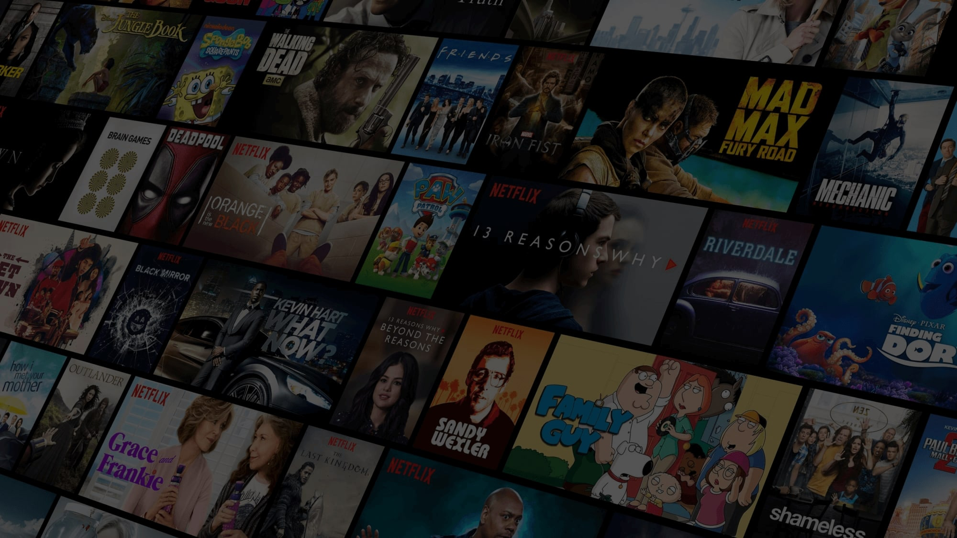
Movie Recommender System
Team 7:
Amulya Balmuri
Vamsi Krishna Malempati
Deepa Pasunooru
Satish Kumar MNV
Swathi Sukumar
Rahul Choubisa

Slide 2
Date: Second-last class (class previous to last class)
• Time per team: 30 minutes including Q&A
• Slides: around 20 slides
• Format (use and modify as appropriate):
• Introduction: very quick review of question and background
• Literature: what others have done on the same topic (if any); what is new in your project
• Data transformations performed – brief overview; list Pandas methods used
• Data Description: source, size, format, table summarizing input and target variables, basic stats of data (e.g., min, max, mean, standard deviation, scatter plot, histogram)
• Data Exploration: regression, clustering, association analysis, time series plots, etc. (do what you feel is appropriate – no need to do all analyses)
• Predictive modeling
• Models tried
• Input variables tried
• Data Transformation
• Model selection
• RMSE, Misclassification, ROC, etc.
• Profit-Loss Analysis
• Findings
• Recommendations for Business

Slide 3
Agenda
Introduction - Amulya
EDA/Feature engineering - Satish and Vamsi
Collaborative Filter - Swathi
Content based filter - Rahul
Recommandation UI and Insights - Deepa

Slide 4
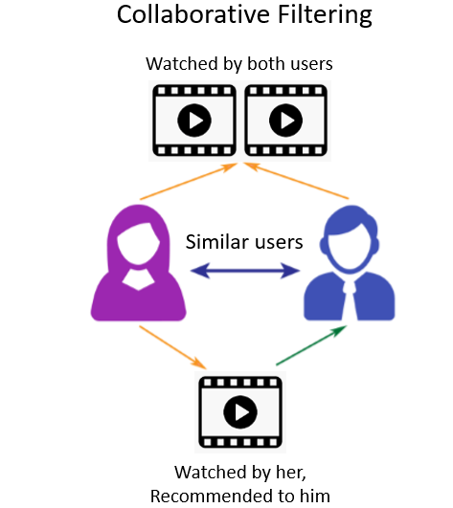
Business Relevance
In this rapidly changing world people are always looking for a easier way out in all things that also include recommendations for what they might like. Hence recommender systems has been increasingly popular in a day to day life.
Recommender systems aim to predict users' interests and recommend product/services that quite likely are interesting for them.
In this project we will be discussing how to build a Movie Recommendation System using collaborative filtering by implementing the K-Nearest Neighbors algorithm.

Slide 5
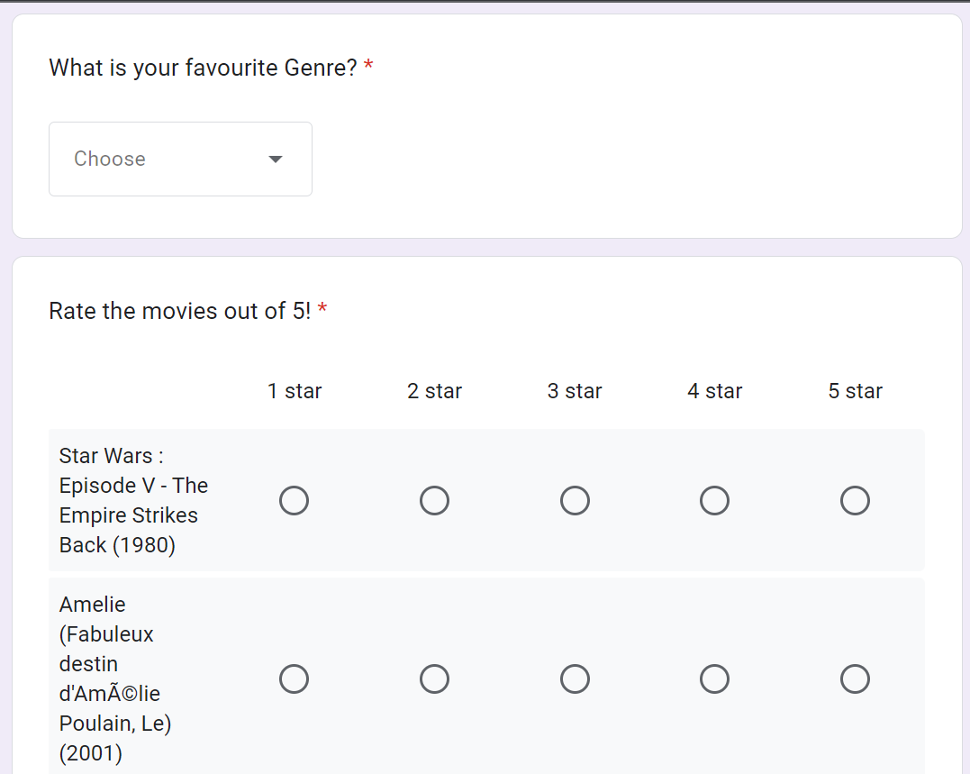
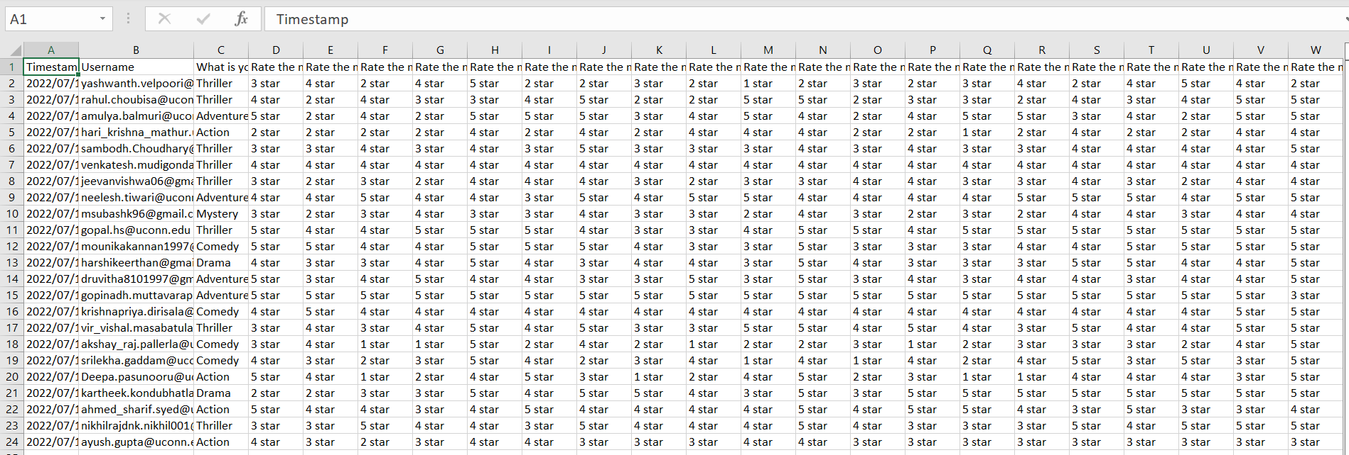
Literature Survey and What’s new?
1.Introduction To Recommender Systems Published in Towards Data Science Link
2.TF-IDF and similarity score published on Chan`s Jupyter - Link
Google form to collect the data from Real Users

Slide 6

Questions to be explored
What is the most liked in each year?
The best movies of all time between 1996 to 2015 based on the average ratings?
What is the change in trend of the movie genres over the period of time from 1990’s to 2020’s?
Identifying the highest relevant movies for a particular one based on both ratings and genres?

Slide 7
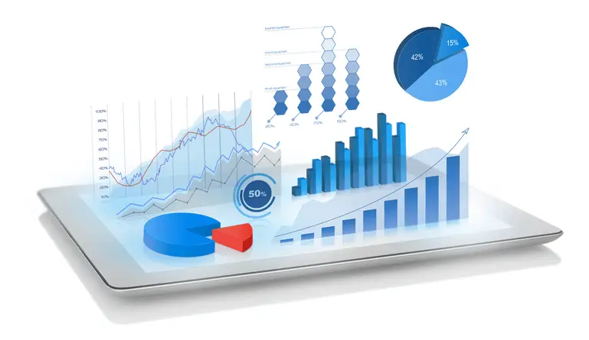
Dataset & Data Collection Plan
The dataset is taken from the Kaggle - https://www.kaggle.com/datasets/grouplens/movielens-20m-dataset?select=movie.csv
The datasets describe ratings and free-text tagging activities from MovieLens, a movie recommendation service.
It contains 20,000,263 ratings and 465,564 tag applications across 27,278 movies.
These data were created by 138,493 users between January 09, 1995 and March 31, 2015.This dataset was generated on October 17, 2016.
Users were selected at random for inclusion. All selected users had rated at least 20 movies.

Slide 8
Data Description
tag.csv | rating.csv | movie.csv | link.csv | genome_scores.csv | genome_tags.csv
userId | userId | movieId | movieId | movieId | tagId
movieId | movieId | title | imdbId | tagId | tag
tag | rating | genres | tmbdId | relevance
timestamp | timestamp

Slide 9
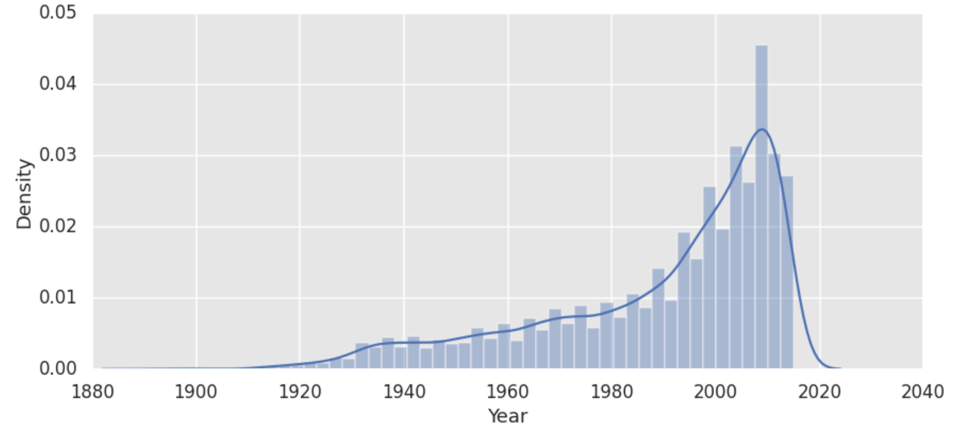
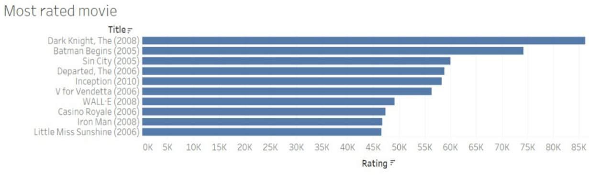
EDA
The Entertainment industry has grown rapidly over the years, which can be seen in the graph and also, we observed the learning curve by post 20th century with respect to the movies
In each year different movie genres have been picked based on aggregate rating.
In the year 2008 (Dark knight) has got the highest of 85k when compared to all other movies.

Slide 10
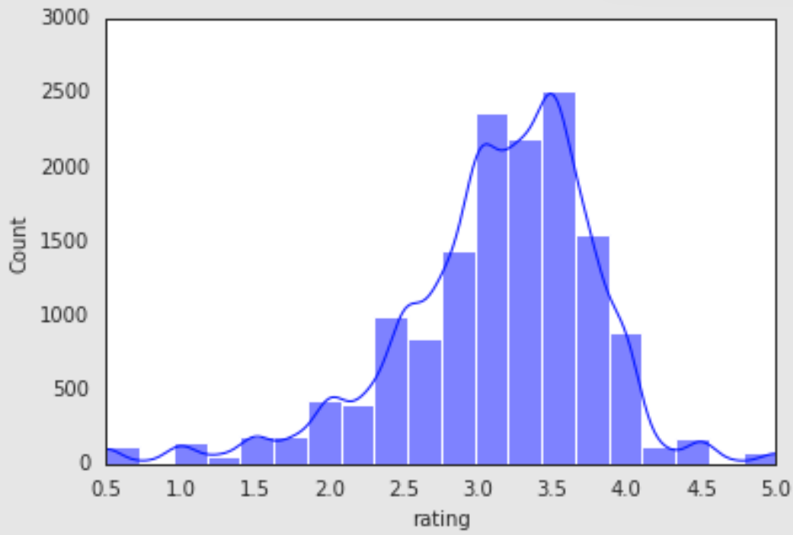
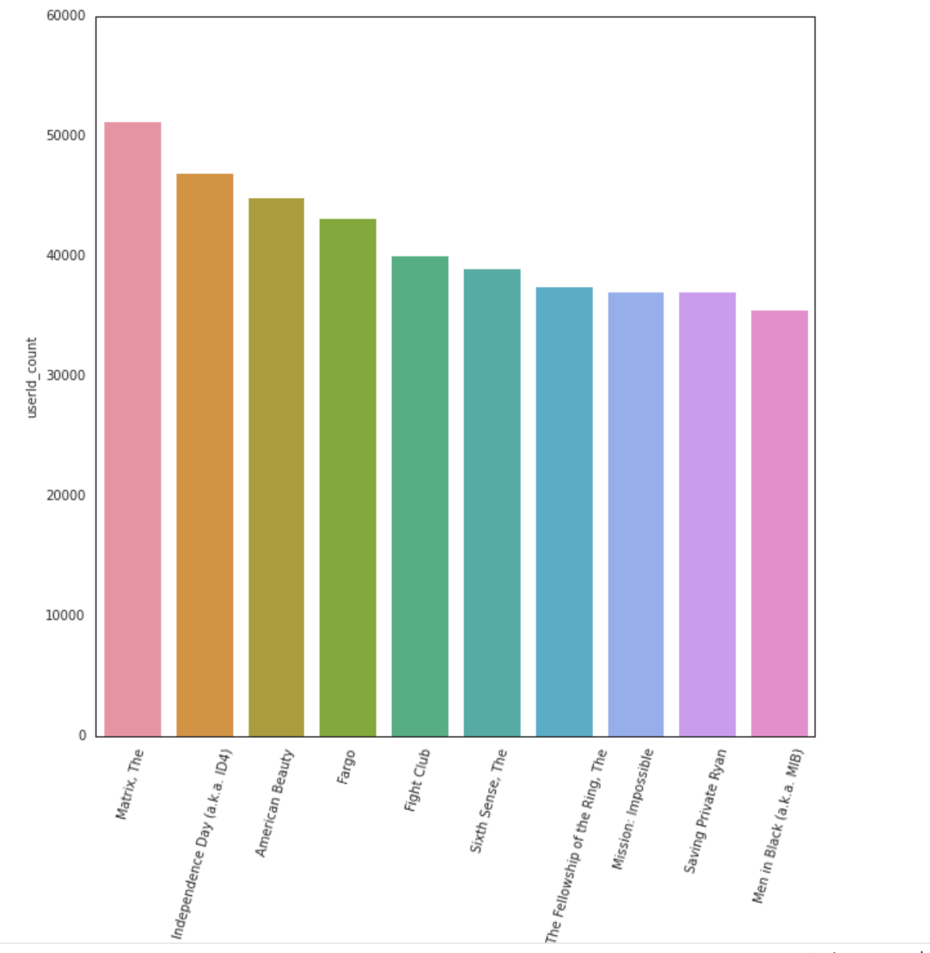
EDA
These are the highest ratings given by the users, and the other graph can explain about the largely rated movie in the particular year, rated by the particular user.

Slide 11
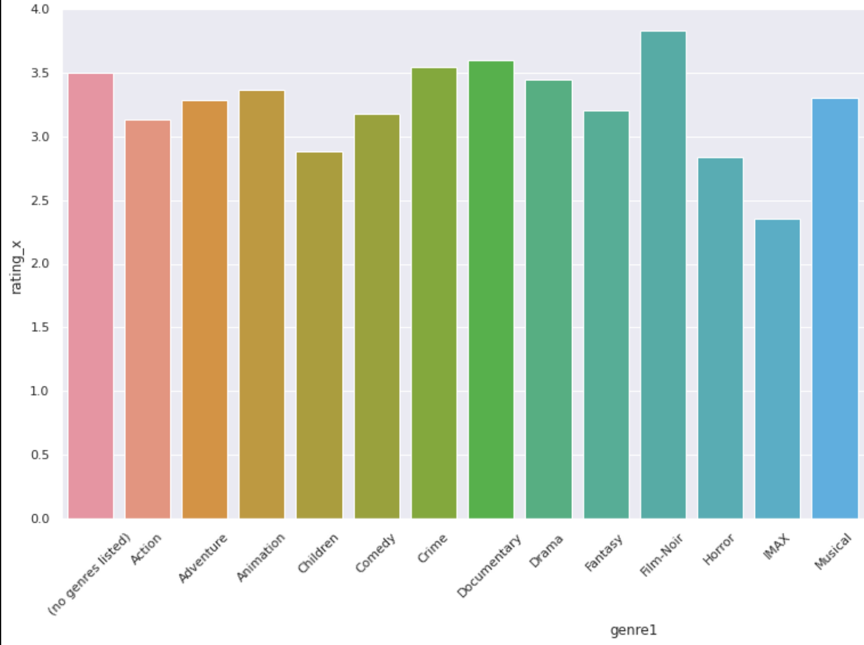
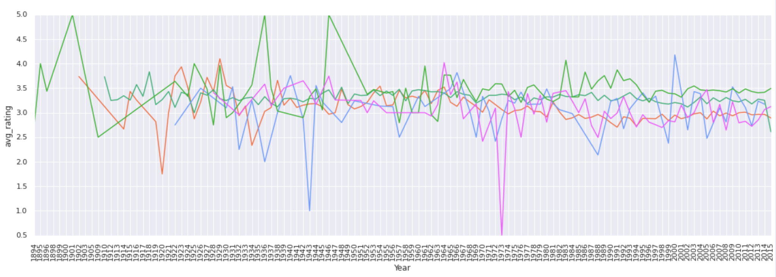
EDA
Based on the rating, we observed that (film_noir) got the highest rating genre and the least rated genre is (Horror).
Over the period of time, almost all genres maintained equilibrium, with peak times for certain genres.
Action Orange
Drama green
Mystery blue
Documentary light green
Thriller pink

Slide 12
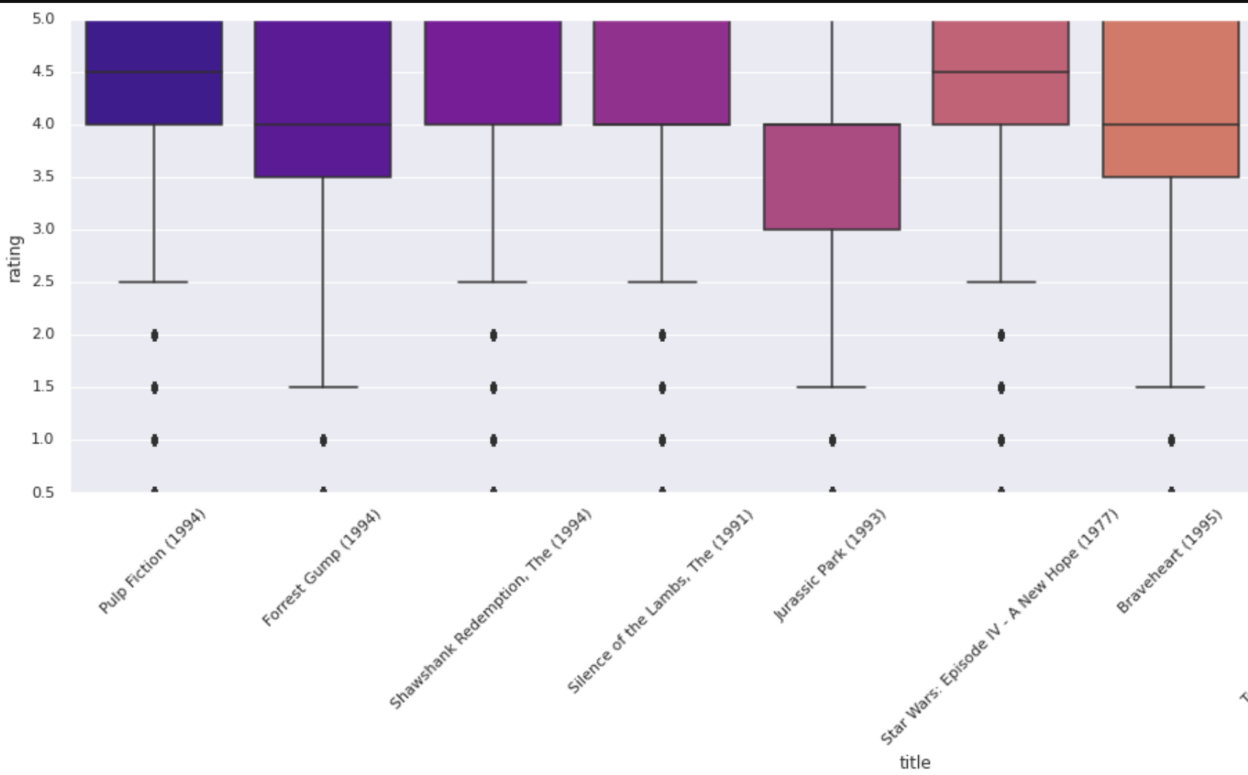
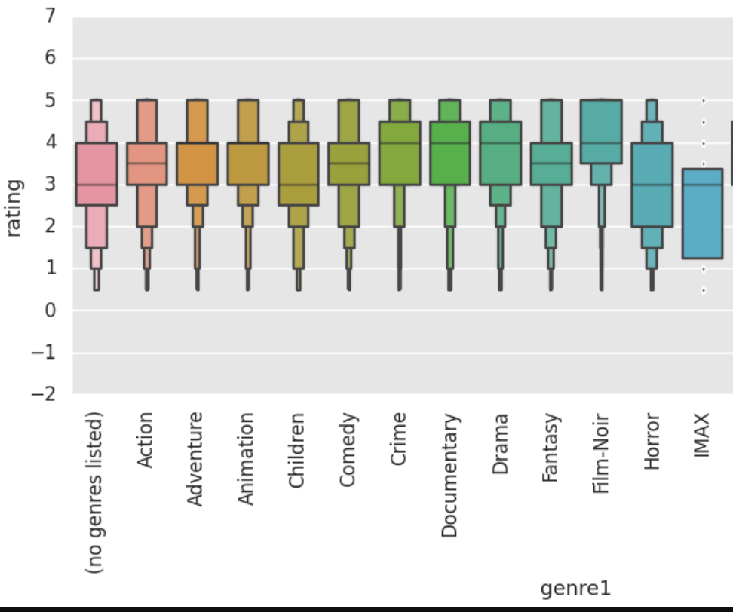
Data Exploration

Slide 13
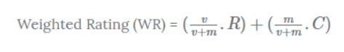
Data Selection
We need a metric to score or rate movie
We will merge the movie and ratings data
Calculate the score for every movie
Sort the scores and recommend the best rated movie to the users.
V is the number of votes for the movie; M is the minimum votes required to be listed in the chart(40); R is the average rating of the movie; And C is the mean vote across the whole report
Data Selection Code

Slide 14
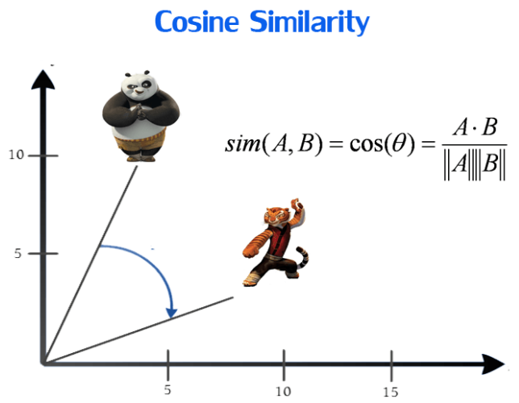
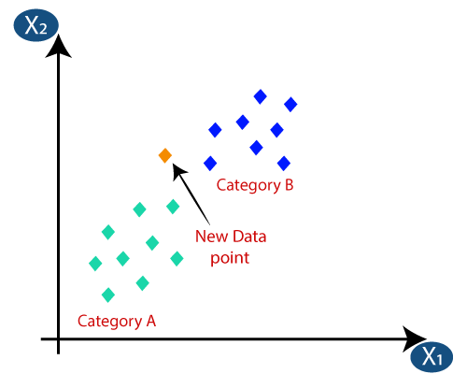
Collaborative Filtering
Uses other users’ preferences and taste to recommend new items to a user. Find similar users (or items) to recommend new items which where liked by those users,
Merge the datasets : Comprehensive list of userid,movie id and ratings were formed
Pivot the dataset: To form a NxM table with ratings as its values and user-id and movie-id as it columns and index
Convert pivot table into a vector matrix: Using the csr_matrix library
Find the K-Nearest Neighbours: For a randomly chosen movie
Use cosine similarity: The distance measure within KNN model is cosine similarity.
Click here for Code

Slide 15
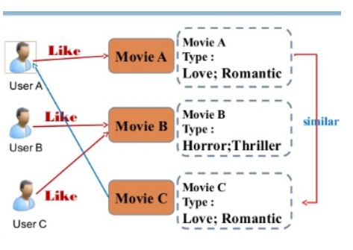
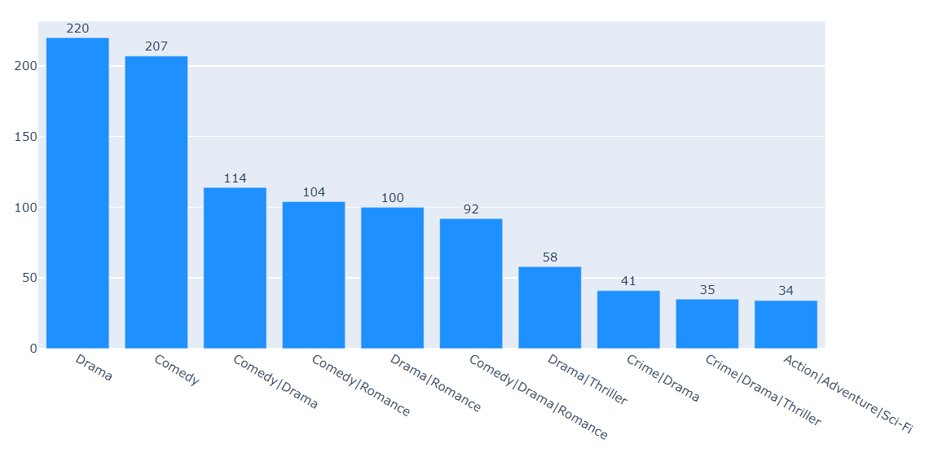
Content Based Filter
Recommender system the content of the movie (Genere in this case) is used to find its similarity with other movies

Slide 16
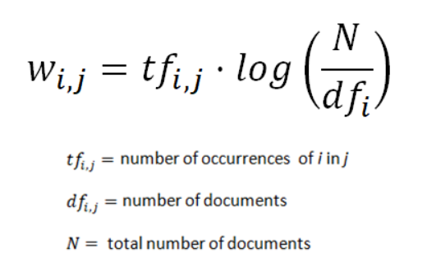
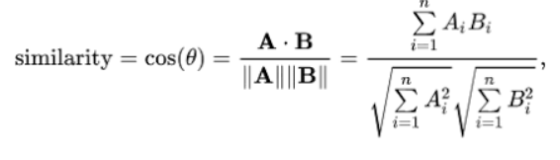
Content Based Filtering Algorithm
Content based recommenders will instead use data exclusively about the items. Uses genres which defines the content and makes suggestions along genres.
Form vectors of genres : Uses TF-idf factorisation
Use cosine similarity: to find the closest vector for genre and movies
Recommend Genres: using closest vectors and build function.
Take a movie title, cosine similarity matrix and indices series as arguments
Extract pairwise cosine similarity scores for the movie
Sort the scores in descending order
Output titles corresponding to the highest scores
Ignore the highest similarity score (of 1)
Click here for CODE
Notes:
overall importance of each word to the documents in which they appear is equal to TF * IDF
This will give you a matrix where each column represents a word in the overview vocabulary (all the words that appear in at least one document) and each row represents a movie, as before.This is done to reduce the importance of words that occur frequently in plot overviews and therefore, their significance in computing the final similarity score.
We see that over 19 different words were used to describe the 2677 movies in our dataset.
cosine similarity to calculate a numeric quantity that denotes the similarity between two movies

Slide 17
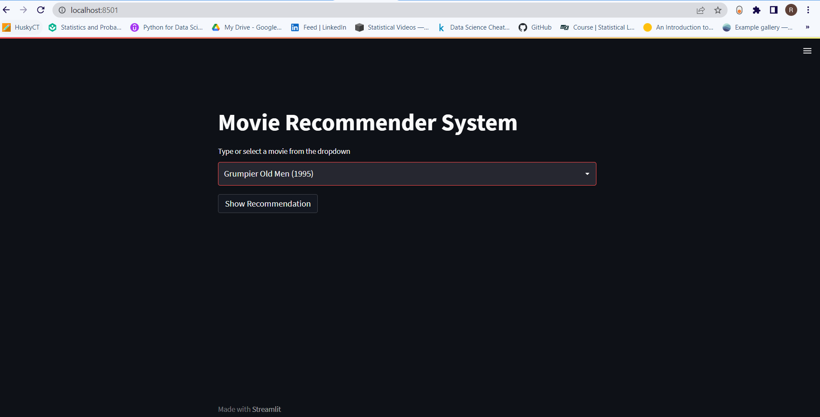
Recommendation Engine UI

Slide 18
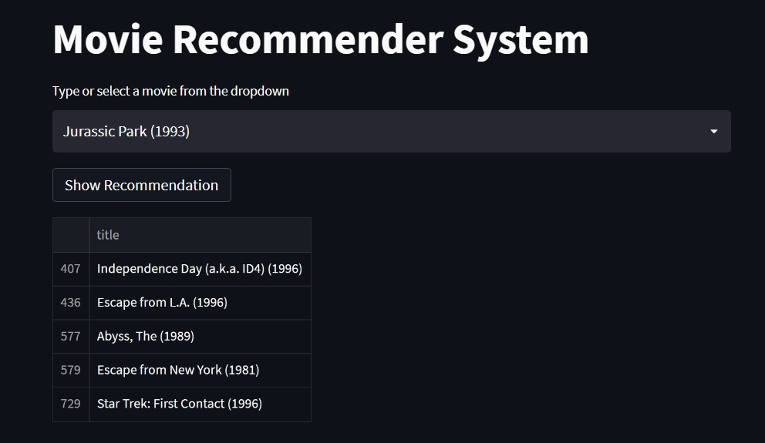
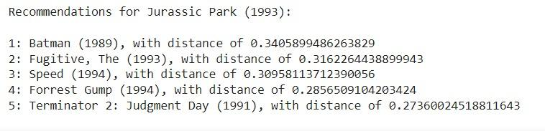
Insights on movie - Jurassic park
Content based Filtering:
Based on content/genre
Collaborative Filtering:
Based on other users preferences

Slide 19


Slide 20
Appendix

Slide 21
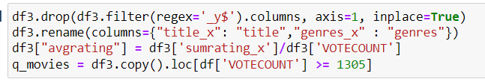
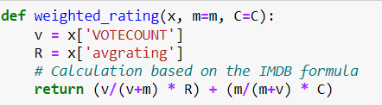
Data Selection Code

Slide 22
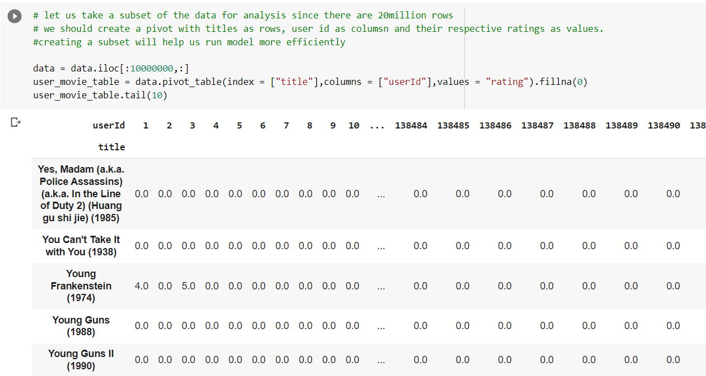
Collaborative Filtering Code - Create a data source

Slide 23
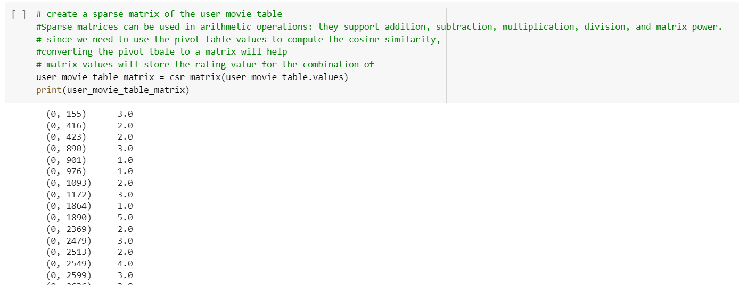
Collaborative Filtering Code - Create a sparse matrix

Slide 24
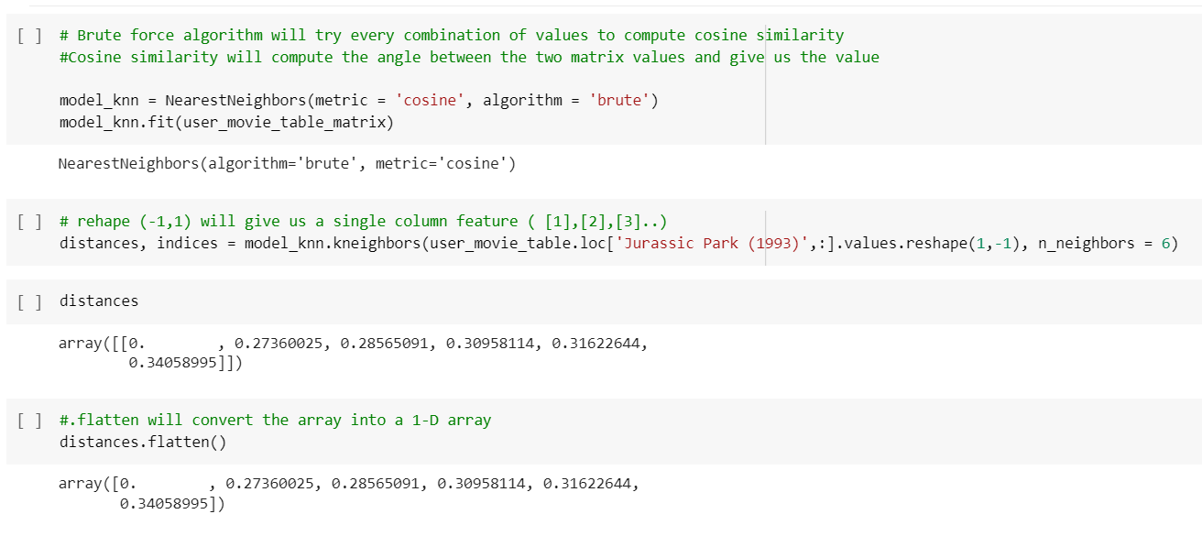
Collaborative Filtering Code - Build a KNN Model

Slide 25
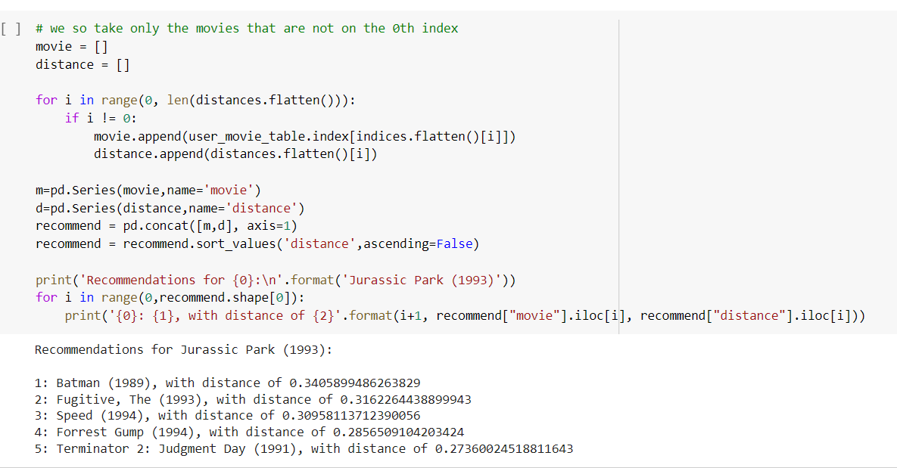
Collaborative Filtering Code - Use distances to retrieve recommendations

Slide 26
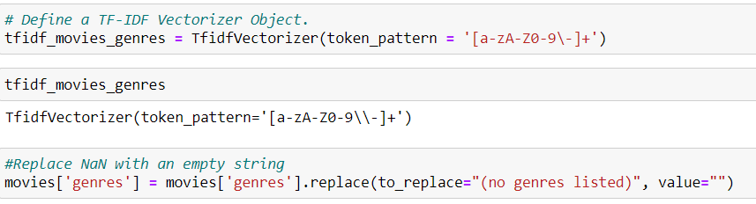
Content Based Code - Building tf-idf Document Vectors

Slide 27
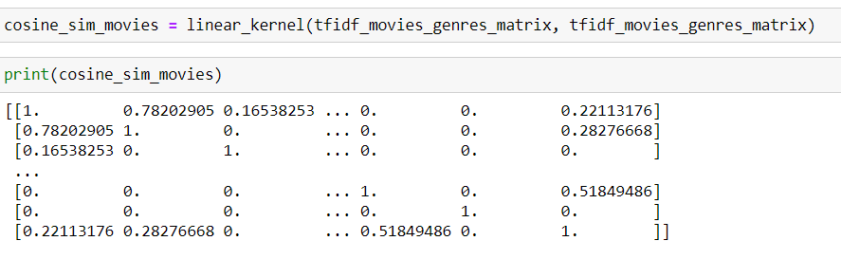
Content Based Code - Cosine Similarity

Slide 28
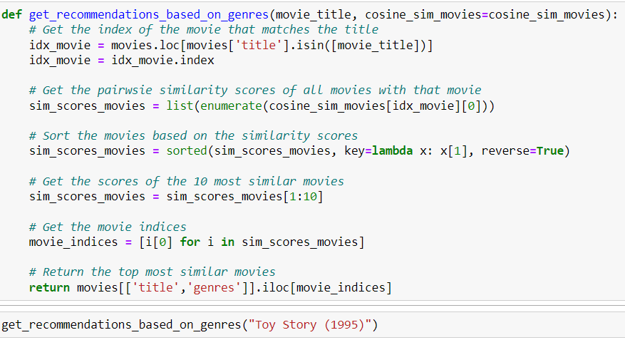
Content Based Code - Recommender Function

